Slide 1
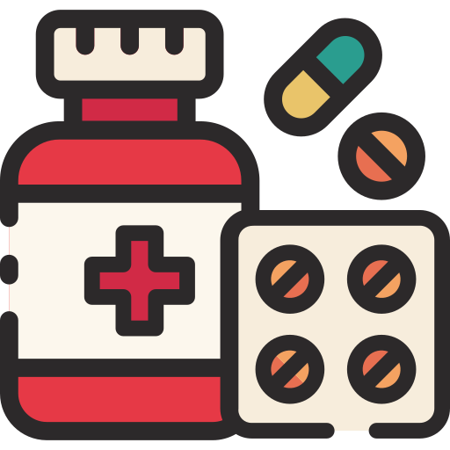
Disease Dynamics: Exploring Disease Mechanisms and Medicine Names through PubMed Analysis
Esra Idil

Slide 2
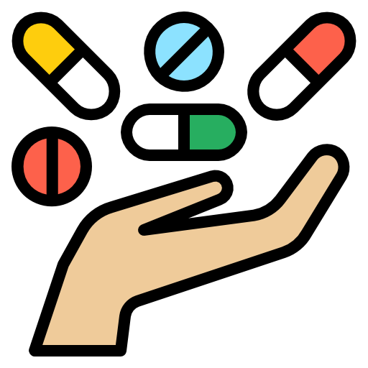
Motivation for the Project
Modern challenges of new drug discovery:
Cost
Length
Uncertainty of results
Limitations of models and more
Drug repurposing is a great tool in this case as it takes advantage of existing drugs with known safety profiles which could potentially mean less time and cost associated with clinical development stages which is why developing tools to speed up the process for repurposing is important

Slide 3

Scope of the Project
This tool speeds up the research process of drug repurposing by automating literature searching and text mining in the pubmed database
This is a powered by natural language processing techniques which is very efficient in searching through large bodies of text
Automating text mining assists researchers in searching, filtering, and understanding hundreds of articles to identify patterns and develop connections from the text at a much faster pace
The user will be able to input biological mechanisms of the disease they wish to explore and they will get a list of relevant articles from pubmed and identified patterns of common medications in these groups
Input Keywords
Output Articles
Output Common Medications

Slide 4
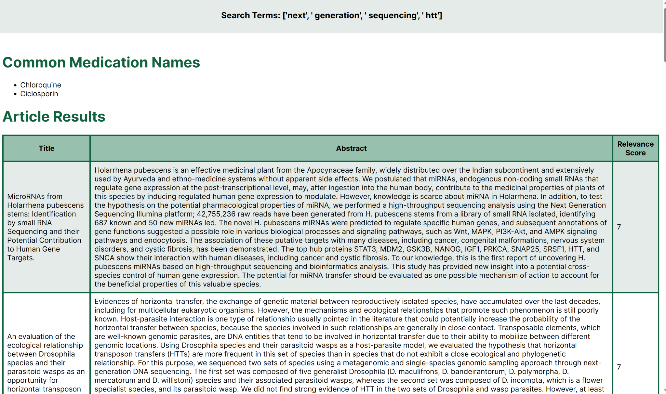
Materials and Methods
This tool will search through pubmed based on the criteria entered by the user and it will return the 100 most relevant articles.
Relevance is determined by the number of times the keywords entered by the user occurs in the article title and abstract
The package drug_name_entity_recognition includes a complete list of the most up to date legal drugs available for use worldwide
Common medication names is determined by searching for those medication names within the output articles

Slide 5
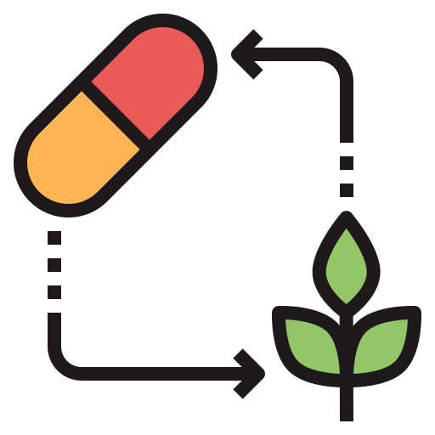
Resources
Programming
Python
HTML
CSS
Packages
Entrez from BioPython: module that allows for pulling of articles from the pubmed database
Xml.etree.ElementTree: allows user to work with xml data
Wordpunct_tokenize from NLTK Tokenizer: divides strings into separate words
Find_drugs from drug_name_entity_recognition: package that has a list of all drugs available for use
Re: regular expressions that execute pattern matching
Databases
PubMed (data)
Flask Web Application

Slide 6
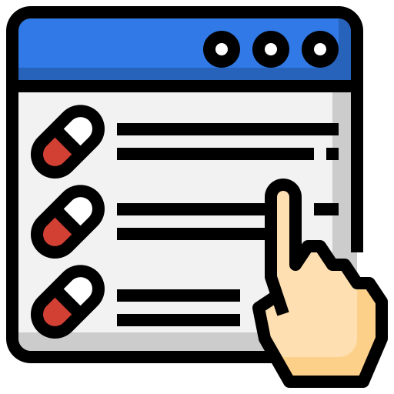
Results
Main Objective:
provide an easy to use tool that researchers can use to speed up the research aspect of drug repurposing
Functionality of Tool:
Allows researcher to input keywords about the disease they wish to research into the search field
Searches through PubMed and returns the 100 most relevant articles with their title and abstract
Calculates a relevance score per article based on how many times the keywords appear in the title and abstract
Returns a list of medication names that appeared in the 100 articles

Slide 7
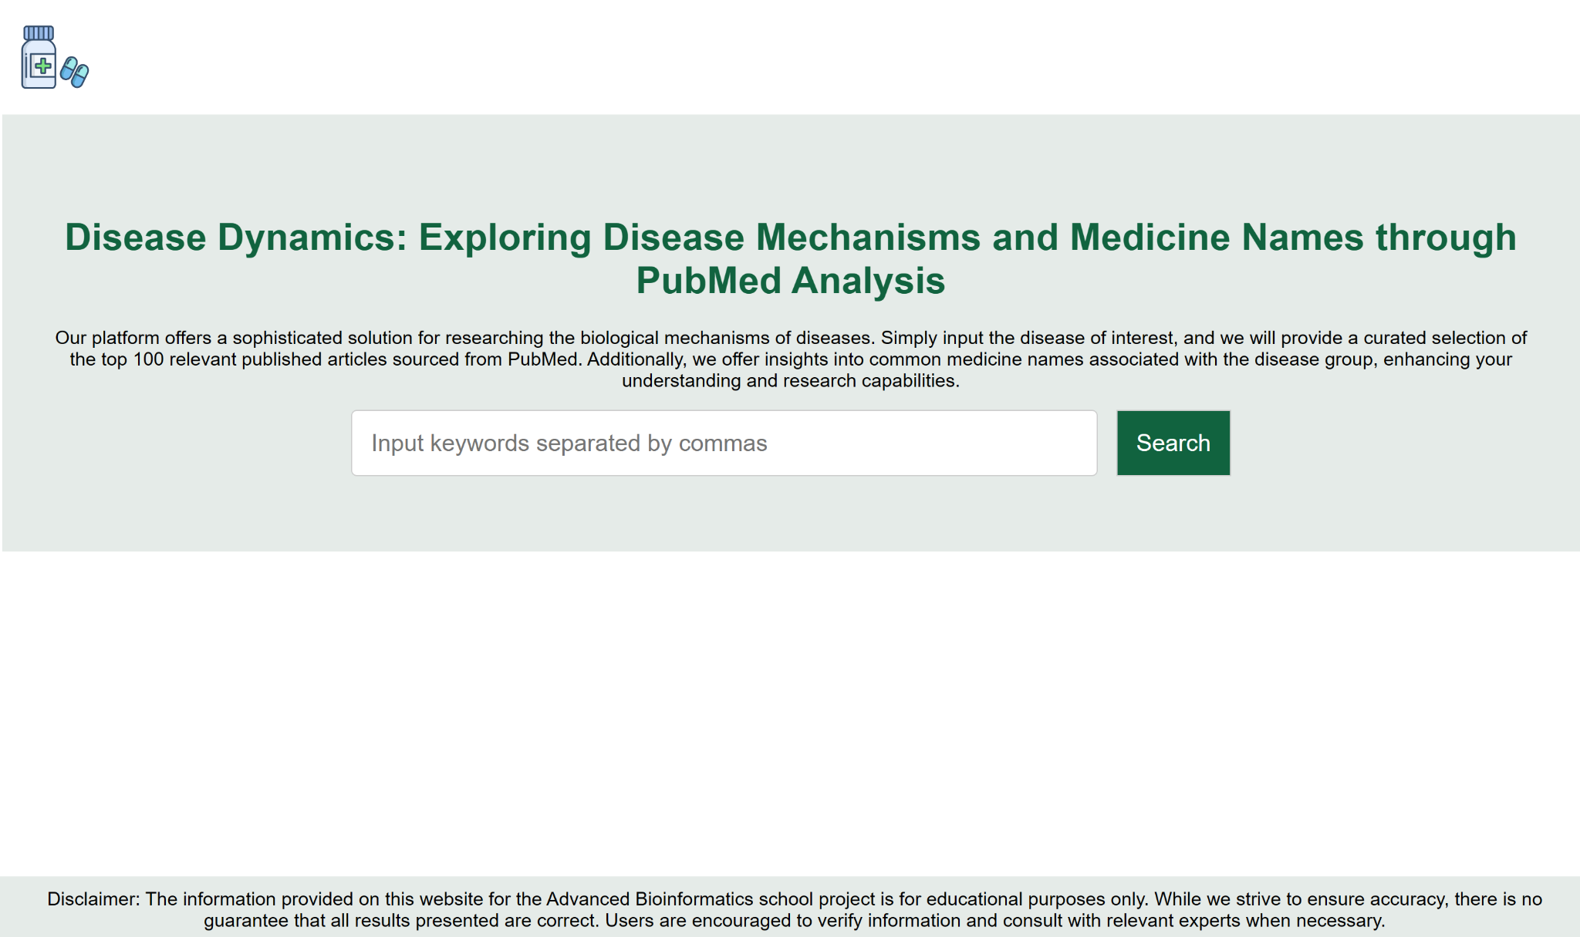
Web Application UI

Slide 8
Examples of User Input
Techniques:
CRISPR/Cas9, RNA interference (RNAi), Next-generation sequencing (NGS), Polymerase chain reaction (PCR), Gene expression profiling, Genome editing, Proteomics, Cell culture
Gene Names:
BRCA1/BRCA2, CFTR, FMR1, HTT, DMD, APC, TP53, SOD1, LDLR, GBA
Other Terms:
Pharmacogenomics, Stem cell therapy, Immunotherapy, Bioinformatics, Epigenetics, Precision oncology, Gene regulation

Slide 9
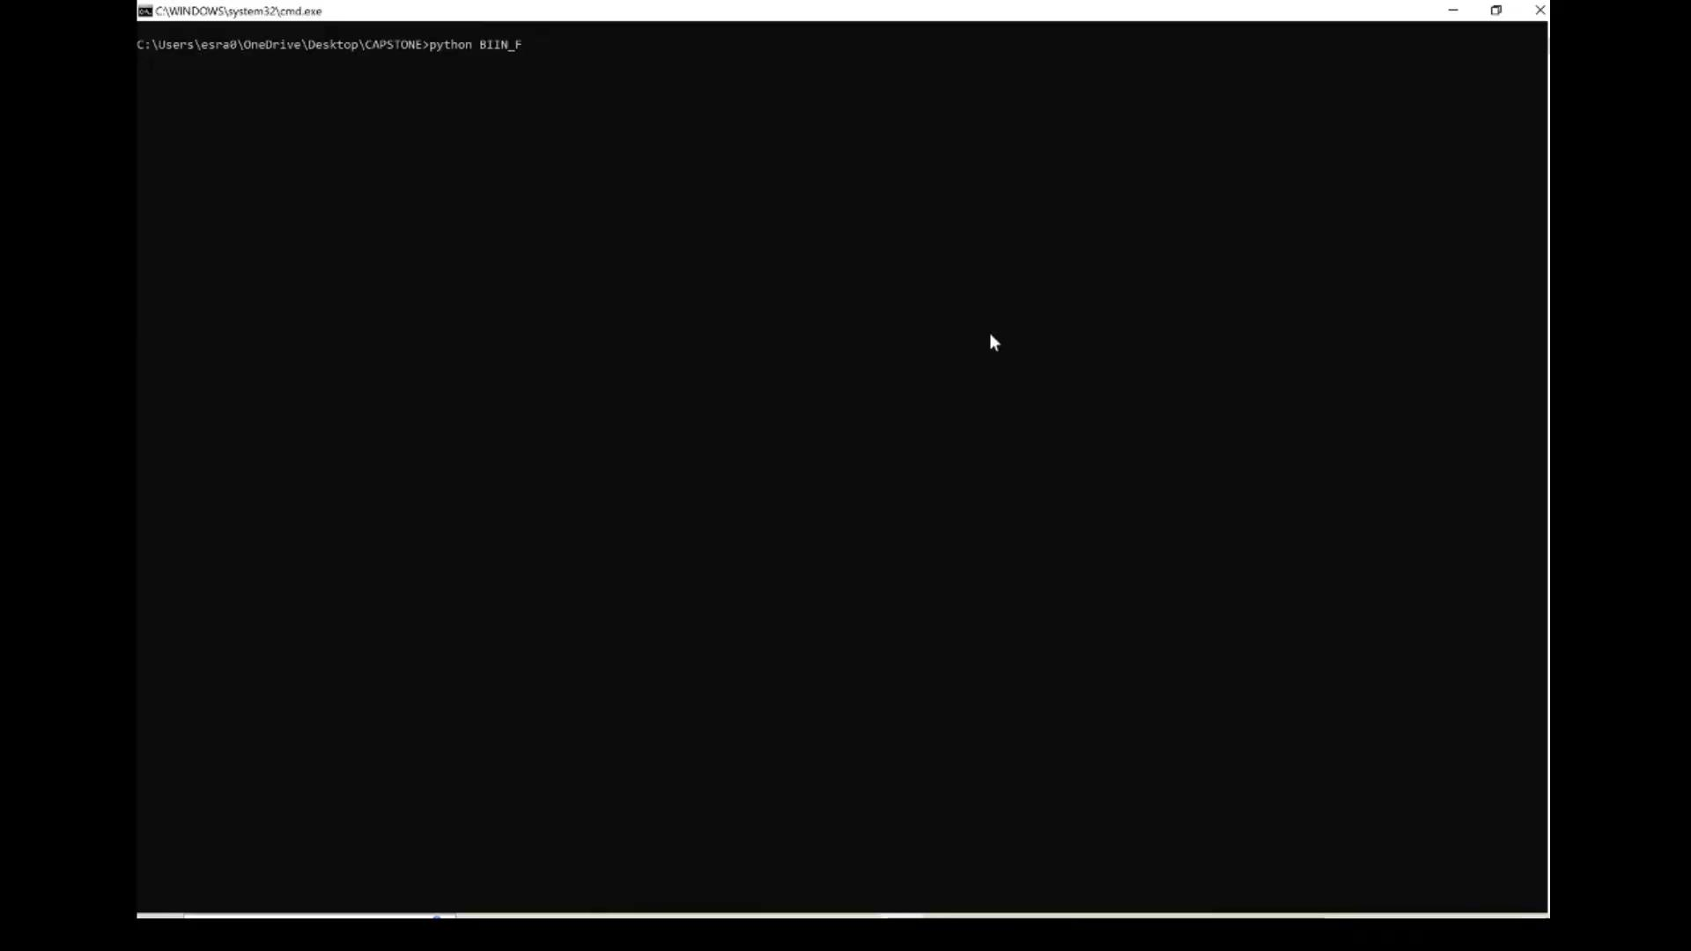
Disease Dynamics Tool Video Demonstration

Slide 10
Sources
https://www.elsevier.com/industry/drug-repurposing
https://www.ncbi.nlm.nih.gov/pmc/articles/PMC9945820/
https://pubmed.ncbi.nlm.nih.gov/?term=protein+therapy&filter=simsearch2.ffrft&filter=pubt.review&filter=pubt.technicalreport
https://realpython.com/nltk-nlp-python/
https://www.nltk.org/
https://www.biostars.org/p/17392/
https://realpython.com/python-web-applications/
https://pypi.org/project/drug-named-entity-recognition/
https://www.bing.com/search?pglt=675&q=clipchamp&cvid=a90f82d72ad041b398c5063e4e387356&gs_lcrp=EgZjaHJvbWUqBggCEC4YQDIGCAAQRRg5MgYIARAuGEAyBggCEC4YQDIGCAMQLhhAMgYIBBAAGEAyBggFEC4YQDIGCAYQLhhAMgYIBxAAGEAyBggIEEUYPNIBCDMxODRqMGoxqAIAsAIA&FORM=ANNTA1&PC=U531
https://www.w3schools.com/html/html_images.asp
https://www.w3schools.com/html/html_css.asp
https://www.w3schools.com/html/default.asp
https://docs.python.org/3/library/re.html
https://www.geeksforgeeks.org/reading-and-writing-xml-files-in-python/
https://www.nature.com/articles/d41573-022-00001-9
https://www.sciencedirect.com/science/article/abs/pii/S1359644618302599#:~:text=A%20comparison%20of%20traditional%20drug%20discovery%20process%20versus,abolishes%20all%20the%20steps%20needed%20for%20FDA%20approval

